Slide 1

Hedging Strategien mit derivativen Finanzinstrumenten ABBeV 03.09.2020
Abbildung Nr.1: https://www.viveresenigallia.it/upload/2019_11/530994_CfakepathTrading.jpg

Slide 2
Table of contents
Original-literature:
-Factors affecting the option prices: 11.1.
-The Greeks: 19.3.-19.9.
-Hedging in detail: 19.1, 19.2, 19.6
1) Determants of the options price
2) The Greeks
2.1) Call Option
2.2) Put Option
2.3) Aussagen der einzelnen Greeks am Beispiel einer Call option
2.4) Concept: Implied volatility
2.5) Hedging styles
3) Examples of static hedging
3.1) Delta Hedging
3.1.1) Reality problems
3.1.2) Input data needed
3.1.3) Example step-by-step
3.2) Delta Gamma Hedging
3.2.1) Input data needed
4) Practice examples in Python
4.1) Assumptions for simulations
5) Literature/ Links
6) Different approaches to time series analysation

Slide 3
Determants of the option price
Abbildung Nr.1: https://www.viveresenigallia.it/upload/2019_11/530994_CfakepathTrading.jpg

Slide 4
Determants of the options price
Black-Scholes-Merton formula
Abbildung Nr.2):
https://www.investresearch.net/wp-content/uploads/2014/02/Black-Scholes.png
(Current) Stock Price: S
Volatility:
Time to maturity: T-t
Interest rate: r
Strike price: K

Slide 5
The Greeks
Abbildung Nr.1: https://www.viveresenigallia.it/upload/2019_11/530994_CfakepathTrading.jpg

Slide 6
The greeks
Single sensitivities of the BSM formula according to the factors 1-4 (Strike price excluded)
(Current) Stock Price: S
Volatility:
Time to maturity: T-t
Interest rate: r
Strike price: K

Slide 7
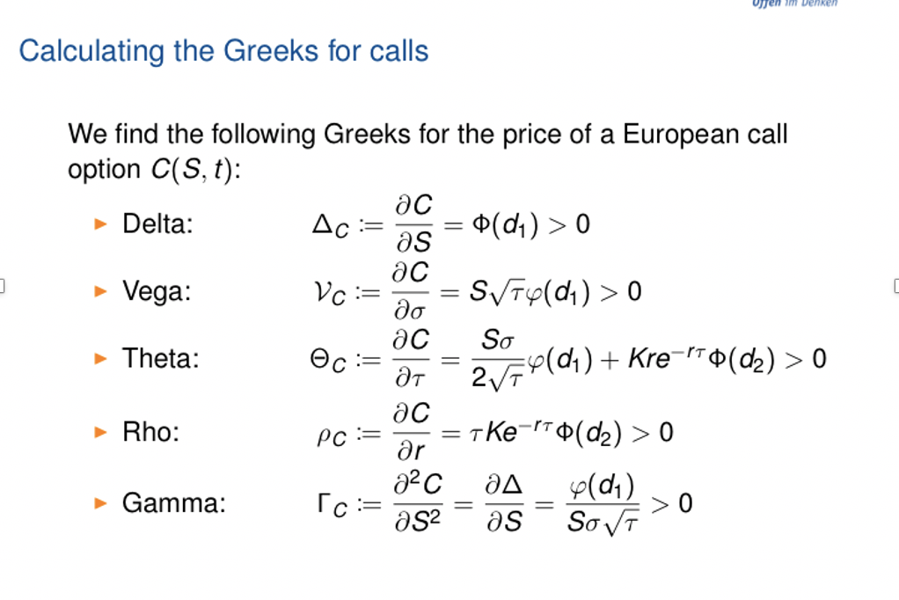
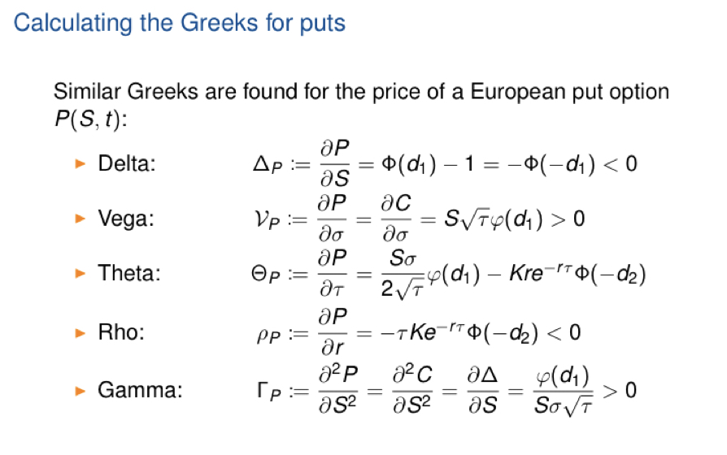
The greeks
Call option Put option
Abbildung Nr.3): Einführung in derivative Finanzinstrument Uni DUE Prof. Dr. Rüdiger Kiesel, Vorlesungsskript, F.7
Abbildung Nr.4): Einführung in derivative Finanzinstrument Uni DUE Prof. Dr. Rüdiger Kiesel, Vorlesungsskript, F.8

Slide 8
The greeks
Call option Aussagen der einzelnen Greeks
Delta: measures the change in the option price with respect to the change in the underlying price S
Vega: measures the change in the option price with respect to the change in the underlying volatility
Theta: measures the change in the option price with respect to the change in the time to maturity
Rho: measures the change in the option price with respect to the change in the interset rate r
Gamma: measures the change in the options Delta with respect to the change in the underlying price S

Slide 9
The greeks
Concept: Implied volatility
Before using the BSM formula to price the options we have to find an appropiate estimate for the volatility:
Estimating the volatility
Estimating it from data of stock price process
Calculating it using options that are already priced on the market
We know from the Vega:
is the first derivation of the Call f.e. after the volatility
is always positive

Slide 10

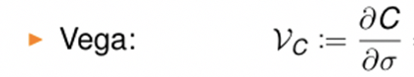

The greeks
Concept: Implied volatility
We know the Vega as:
Vega is always positive
Since Vega is positive: C is a continous strictly incerasing function of
The higher C the higher et vice versa, so we can say: is a strictly increasing function of C:
We can read off the value:
which is corresponding to the actual value at which call options are priced in the market

Slide 11
The greeks
Hedging styles
General questions to ask
1) How does the value of the position change if the value of the underlying changes?
2) How can we protect the position (hedge) against those risks?
Hedgeing = Trading that reduces the risk of a position
Hedging styles
Static hedge
Dynamic hedge
Semi-static hedge
set up once and never touched again until maturity of derivative/ position that is hedged
set up once and adjusted continously
set up once and adjusted at infrequent intervals

Slide 12
Examples of static hedging
Abbildung Nr.1: https://www.viveresenigallia.it/upload/2019_11/530994_CfakepathTrading.jpg

Slide 13
Examples of static hedging
Delta hedging
Situation:
options position with a certain Delta/ delta risk
means: if price of the underlying moves by a (very) small amount e then the price of the options position moves approximately by *e
Aim:
eliminating the delta of the position to make the position independent from the changes in the underlying prices S
Delta hedging:
selling x units of the underlying (or buying if the delta is =< 0) and setting up a portfolio that doesn‘t change ist value if the underlying price changes by a marginal amount
Portfolio then created has a delta of zero, is delta neutral

Slide 14
Examples of static hedging
Delta hedging
Reality problems
In reality:
Delta isn‘t constant so the portfolio has to be adjusted continously
In the BSM model: delta hedge with continous rebalancing is called „perfect hedge“
In practice not possible: portfolio can‘t be protected against larger market movements
Also: transaction costs, bid-ask spreads , trading costs often results in losses

Slide 15
Examples of static hedging
Delta gamma hedging
Input data needed
Position value
Interest rate
Actual stock price (underlying)
Strike price
Time to maturity
Implied volatility
Long 1000 US $
r: 5%
S: 99 US $
K: 104 $
T: 1 month
: 15,7%
How can we make the portfolio delta neutral by investing a certain amount in the underlying stock S?
Sidetask:
What is the profit/ loss for the portfolio when the underlying price S jumps to 100 $?

Slide 16


Examples of static hedging
Delta hedging
example step-by-step
1) Calculating the fair price for the Call option using the BSM formula:
Call: 0,3858 $
2) Calculating the amount of calls in the whole position value:
position value: 1000 $
1000 $/0,3585 $ = 2592 Calls inside the position
3) Calculating the Delta for one Call using the Delta formula:
4) Delta for one Call: 0,1654
5) Delta for the whole position of 2592 Calls:
2592*0,1654 = 428,70
Note: the Delta of the underlying stock is 1!
6) Making the position delta neutral:
Solving: 0 = 428,70+x*1 (x: amount of underlying stocks, 1: delta of the stock)
x = -428,70 -> Go short in 428,70 units of the underlying stock to make the portfolio delta neutral!

Slide 17
Examples of static hedging
Delta hedging
example step-by-step
Portfolio overview:
Short: 428,70 units of the underlying stock
Long: 1000 US $
= 2592 Calls

Slide 18
Examples of static hedging
Delta hedging
example step-by-step
Sidetask:
What is the profit/ loss for the portfolio when the underlying price S jumps to 100 $?
At first: the loss of the short position
428,70*1 = 428,70
Now the underlying price is S=100 $: Calculating the fair value using the BSM formula:
Call(S=100): 0,5808
Calculating the gain of our created delta neutral portfolio:
N*(Call(S=100)-Call(S=99))
2592 Calls*(0,5808-0,3858) = 505,37 $ -> is the value of our created position when S=100 $!
Total Profit:
505,37 $-428,70 $ (Loss from the short position) = 76,67 $
Profit: 76,67 $

Slide 19
Examples of static hedging
Delta gamma hedging
Input data needed
Position value
Interest rate
Actual stock price (underlying)
Strike price
Time to maturity
Implied volatility
r: 5%
S: 99 US $
K: 104 $
T: 1 month
15,7%
Long 1000 US $
: 15,7%
How can we make the portfolio delta and also gamma neutral by investing a certain amount in the underlying stock S?
Sidetask:
What is the profit/ loss for the portfolio when the underlying price S jumps to 100 $?

Slide 20
Examples of static hedging
Delta gamma hedging
As we already know: Delta of a portfolio changes with the price of the underlying -> so it has to be rebalanced frequently
=> Delta hedge for a portfolio with a high absolute Gamma has to be monitored more carefully than a Delta Hedge for a portfolio with a Gamma = 0
Remember: Gamma measures the change in the option‘s Delta with respect to the change in the underlying price S
To decrease hedging error: Trader might want to make a delta neutral portfolio even gamma neutral
Problem: Gamma can‘t be changed by investing in the stock because its Gamma is zero!
A new strategy is required:
Portfolio Gamma neutral by investing in an other option
Making the whole portfolio delta neutral by investing in the stock

Slide 21
Examples of static hedging
Delta gamma hedging
Input data needed
First option:
Position value
Interest rate
Actual stock price (underlying)
Strike price
Time to maturity
Implied volatility
r: 5%
S: 99 US $
K: 104 $
T: 1 month
15,7%
Long 1000 US $
: 15,7%
We use the same input data as last time when we only created a delta neutral position, but now we have (need) an additional option to trade with:
Second option:
Call option
Strike K: 97 $

Slide 22
Examples of static hedging
Delta gamma hedging
example step-by-step
1) Calculating the Gamma for the Call option with Strike K: 104 $ using the BSM Greek formula for the Gamma:
Gamma Call (K=104): 0,0554
2) Calculating the Gamma for the Call option with Strike K: 97 $ using the BSM Greek formula for the Gamma:
Gamma Call (K=97): 0,0758
3) Creating the Gamma neutral portfolio:
We have to build up a position of x*Call(K=97 $) so that we have:
2592*0,0554+x*0,0758 = 0
Solving: x: -1894,74 units of the K=97 $ Call Option short to create a Gamma neutral portfolio
Now making the Gamma neutral position also delta neutral:
4) Delta for the K=104 $ Call: 0,1654 , Delta for the K=97 $ Call: 0,7139
5) Delta for the whole position of 2592 Calls:
2592*0,1654-1894,74*0,7139 = -924,02
Note: the Delta of the underlying stock is 1!
6) Making the position delta neutral:
Solving: Go long in x: 924,02 units of the underlying stock to make the portfolio also delta neutral!

Slide 23
Examples of static hedging
Delta gamma hedging
example step-by-step
Sidetask:
What is the profit/ loss for the portfolio when the underlying price S jumps to 100 $?
The price of the K=97 $ Call Option with an underlying of S=99 $ is: 3,2235 $
The price of the K=97 $ Call Option with an underlying of S=100 $ is: 3,9735 $
Calculating the P/L from the position in the K=97 $ Call option is:
-1894,97*(3,9735-3,2235) = -1421,11
Calculating the P/L from the position in the stock is: 924,02
The P/L for the whole portfolio is:
924,02-1421,11+505,37 = -8,28

Slide 24
Practice examples in Python
Abbildung Nr.1: https://www.viveresenigallia.it/upload/2019_11/530994_CfakepathTrading.jpg

Slide 25
Practice examples in Python
Assumptions for simulations
Notizen:
Apple CSV Datei einlesen
Auf bestimmten 10 perodenzeitraum die schlusskurse begrenzen
In der ersten untersuchten periode das hedging portfolio aufsetzen
Dann für die fortlaufenden 9 den P/L des Portfolios untersuchen: wenn stock up dann verlust bei short underlying
Wenn stock down dann gewinn bei short usw.

Slide 26
Literature
Abbildung Nr.1: https://www.viveresenigallia.it/upload/2019_11/530994_CfakepathTrading.jpg

Slide 27
Literature
Illustrations:
Abbildung Nr.1: https://www.viveresenigallia.it/upload/2019_11/530994_CfakepathTrading.jpg , Folie Nr.1
Abbildung Nr.2): https://www.investresearch.net/wp-content/uploads/2014/02/Black-Scholes.png, Folie Nr.4
Abbildung Nr.3): Einführung in derivative Finanzinstrument Uni DUE Prof. Dr. Rüdiger Kiesel, Vorlesungsskript, F.7
Abbildung Nr.4): Einführung in derivative Finanzinstrument Uni DUE Prof. Dr. Rüdiger Kiesel, Vorlesungsskript, F.8
Weblinks:
LaTex Formeleditor: https://www.zahlen-kern.de/editor/
Alles was ich fürs Code schreiben benutz habe:
https://stackoverflow.com/questions/17812978/how-to-plot-two-columns-of-a-pandas-data-frame-using-points
https://pandas.pydata.org/pandas-docs/stable/user_guide/visualization.html
https://pandas.pydata.org/pandas-docs/version/0.13.1/indexing.html
https://www.data-science-architect.de/spalten-zeilen-erstellen-loeschen-und-sortieren-in-pandas/
http://anh.cs.luc.edu/handsonPythonTutorial/ifstatements.html
https://www.geeksforgeeks.org/python-pandas-dataframe-abs/
https://pandas.pydata.org/pandas-docs/stable/reference/api/pandas.DataFrame.values.html
https://www.data-science-architect.de/selektieren-von-daten-in-dataframes/
https://nbviewer.ipython.org/github/twiecki/financial-analysis-python-tutorial/blob/master/1.%20Pandas%20Basics.ipynb
https://stackoverflow.com/questions/39921549/storing-the-results-from-a-function-into-a-retrievable-dataframe-in-python
https://www.it-swarm.dev/de/python/anwenden-einer-funktion-mit-mehreren-argumenten-um-eine-neue-pandas-spalte-zu-erstellen/1043046837/
https://www.it-swarm.dev/de/python/auswaehlen-mehrerer-spalten-einem-pandas-datenrahmen/1068562049/
https://www.programiz.com/python-programming/list
https://aaronschlegel.me/black-scholes-formula-python.html
https://pandas.pydata.org/pandas-docs/stable/reference/api/pandas.DataFrame.insert.html
https://www.delftstack.com/de/howto/python-pandas/how-to-add-new-column-to-existing-dataframe-in-python-pandas/
https://www.python-kurs.eu/python3_funktionen.php
https://datacarpentry.org/python-ecology-lesson/03-index-slice-subset/index.html
https://riptutorial.com/de/pandas/example/5621/loschen-sie-eine-spalte-in-einem-dataframe
https://www.data-science-architect.de/selektieren-von-daten-in-dataframes/
https://github.com/schubbiaschwilli/schubbiaschwilli/blob/python/DeltaHedgeBSM_Call.py
https://www.pricederivatives.com/en/simple-example-simulation-of-delta-hedging-with-python/
https://www.grund-wissen.de/informatik/python/scipy/pandas.html
https://stackoverrun.com/de/q/3553148
https://datatofish.com/create-pandas-dataframe/

Slide 28
Different approaches to time series analysation
Abbildung Nr.1: https://www.viveresenigallia.it/upload/2019_11/530994_CfakepathTrading.jpg

Slide 29
Different approaches to time series analysation
The importance of a non constant volatility measure
Backround:
volatility of a stock measures the uncertainity about stock price movements
relevant both for valuing derivatives an calculating risk measures
Valuing derivatives
Calculating Risk measures
most interested in current volatilities because assessing possible changes in the value over a very short period of time
forecasts of volatilities over the whole life of the derivative are usually required

Slide 30
Different approaches to time series analysation
The importance of a non constant volatility measure
Volatility models
Weighted moving average
(WMA)
Exponentially weighted moving average
(EWMA)
Autogressive conditional heteroscedasticity
(ARCH)
Generalized Autogressive conditional heteroscedasticity
(GARCH)
Best feature of them all:
Take into account that volatility isn‘t constant, changes over time
Using the implied volatility

Slide 31



Different approaches to time series analysation
Different volatility models in detail
Volatility models
Weighted moving average
(WMA)
Exponentially weighted moving average
(EWMA)
goal is to estimate the current level of volatility
using the implied estimate (dailiy Stock price observation), all m returns are given equal weights 1/m
but it is reasonable to give more weight to more recent observations as they are more relevant to future price movements :
exponentially weighted moving average
weights alpha i decrease exponentially as we move back in time
weights are determinde by:
Reduces to a simple recursive formula for updating volatility estimates:
Weight of the observation i days ago
must sum up to unity
If we choose:
less weight to long ago observations
equally weighted average
Central parameters:
Estimate for is made for day n (at end of day n-1) calculated from:

Slide 32





Different approaches to time series analysation
Different volatility models in detail
Volatility models
Autogressive conditional heteroscedasticity
(ARCH)
Generalized Autogressive conditional heteroscedasticity
(GARCH)
extension of the WMA model
assuming that there is a long run average variance: V(L) which should be given some weight y:
Natural generalization of the ARCH(m) is to incorporate the last q estimates of the variance as well
Yields the model:
Weights y and alpha must sum up to:
Defining:
So we can write:
Setting:
Most popular model: GARCH(1,1) model
GARCH(1,1) = long run average variance + EWMA

Slide 33
Different approaches to time series analysation
Combining the implied volatility concept and volatility indices
Recap:
implied volatility is the volatility that gives the market price of the option when it is substituted into the pricing model
Example:
Price of a european Call Option (no dividends) is C(S0)=1,875; S0=21; K=20; r=0,1; T=0,25
Implied volatility is now the value of sigma when substituted in the BSM formula that gives us C(S0)=1,875
Central problem: not possible to just simply solve the BSM equation for the parameter sigma
Work around and use in practice:
implied volatility is used to monitor the market‘s opinion about volatility of a particular stock
Historical volatility
Implied volatility
Backward looking
Forward looking

Slide 34
Different approaches to time series analysation
Combining the implied volatility concept and volatility indices
traders often use the implied volatility of an option rather than its price because the volatility is more convenient, less likely to to variey, used to estimate appropiate implied volatilities for other options
Use in volatility indices
indices are designet to measure the market‘s expectation of future volatility implied by option prices
most popular one: VIX (uses implied volatility of 30 day options on the S&P 500 calculated from a wide range of calls and puts)
Other ones: VXN (on Nasdaq)
VXD (on Dow Jones)

